Slide 1
Structure Investigation of Fam20C, A Golgi Casein Kinase
Sharon Grubner
National Taiwan University
Seventh Weekly report – August 7th, 2013

Slide 2
Progress
FTProd
Uploaded all output pdb files from FTMap together to VMD, aligned and analyzed them using the plugin FTProd in order to find ‘consensus’ sites on Fam20C surface
Read papers about electrostatics in context of drug discovery
VolMap
Using VMD plug-in VolMap, found that there is water present in the ADP binding pocket ~65% of the simulation time.
Continued qualitative analysis
My progress is being updated on a daily basis and shared with my mentors on Evernote.

Slide 3
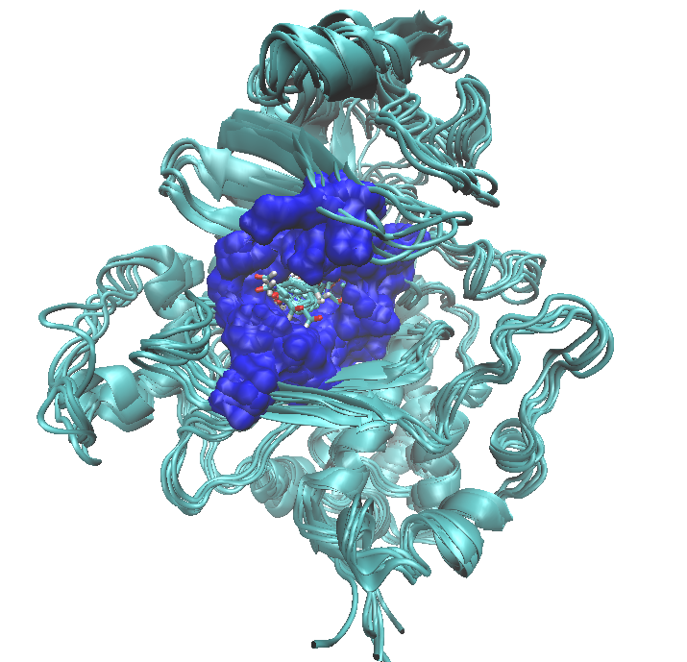
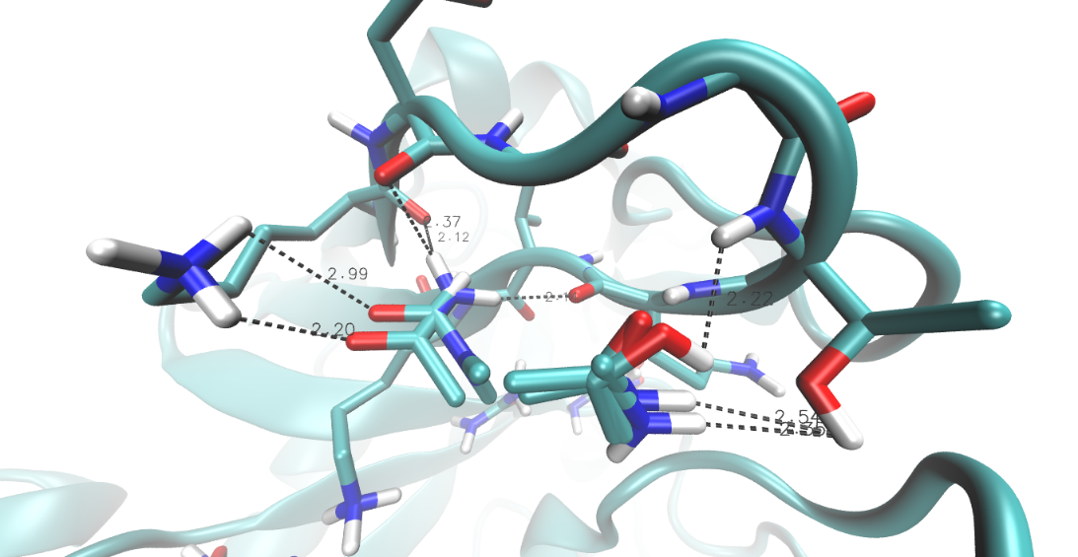
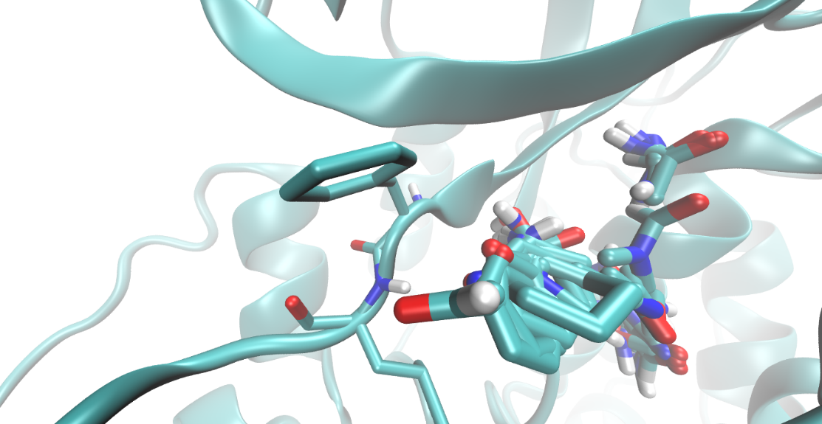
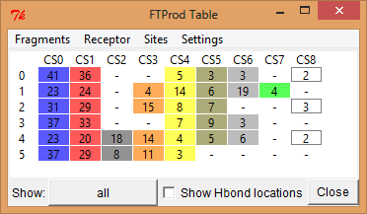
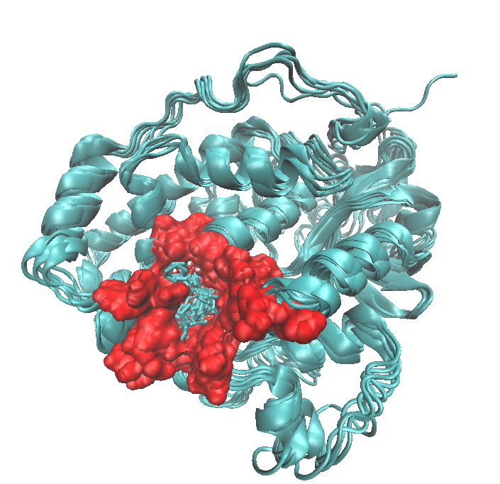
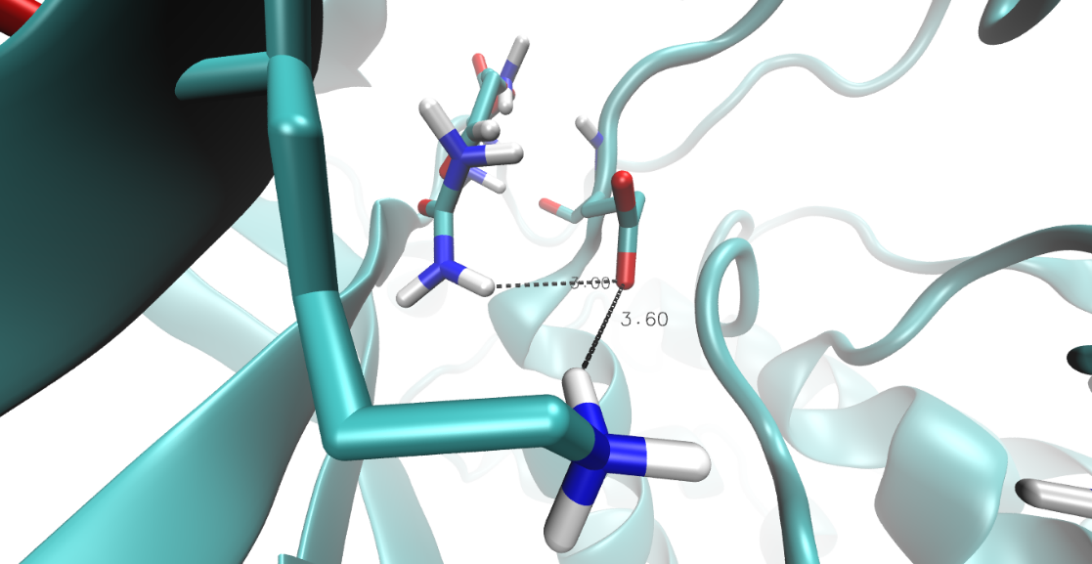
FTProd

Slide 4
Goals for Next Week
FTProd
Confirm my ‘consensus’ sites analysis with my mentors and repeat some aspects of the analysis if necessary
VolMap
Confirm my water occupancy results with my mentors and continue analysis
Learn about enthalpy-entropy compensation and use that information to analyze the movement of Fam20C ‘hinge’ residues
Continue qualitative analysis

Slide 5
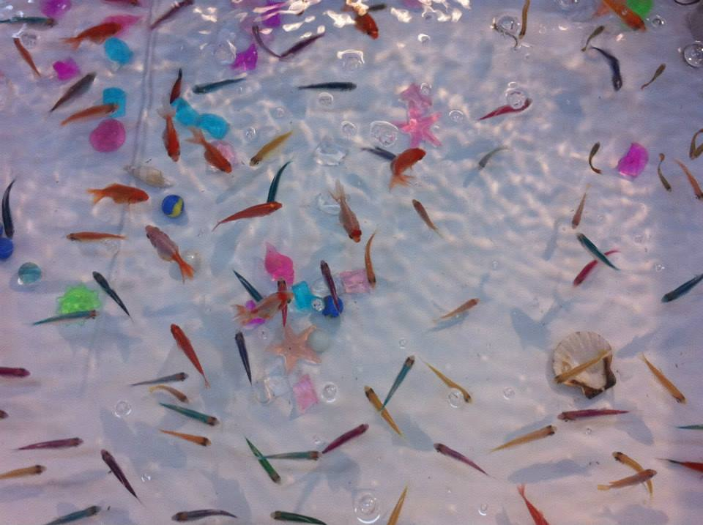
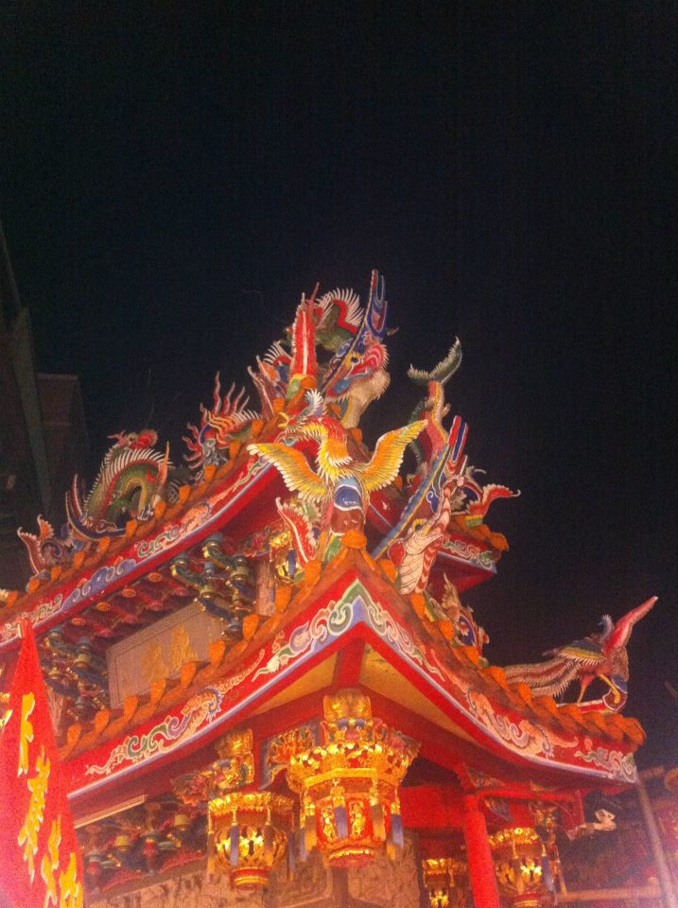
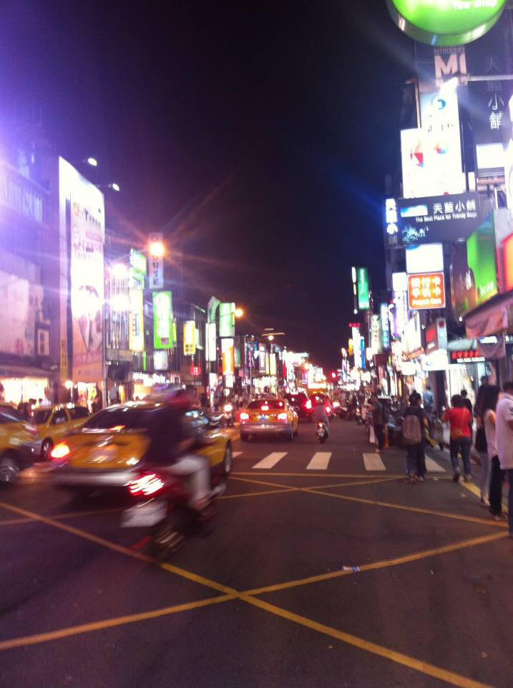

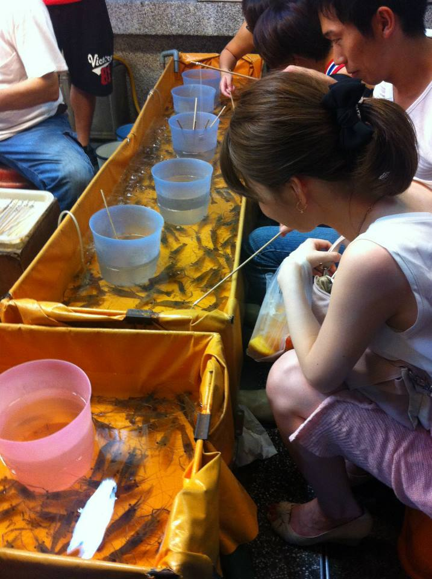
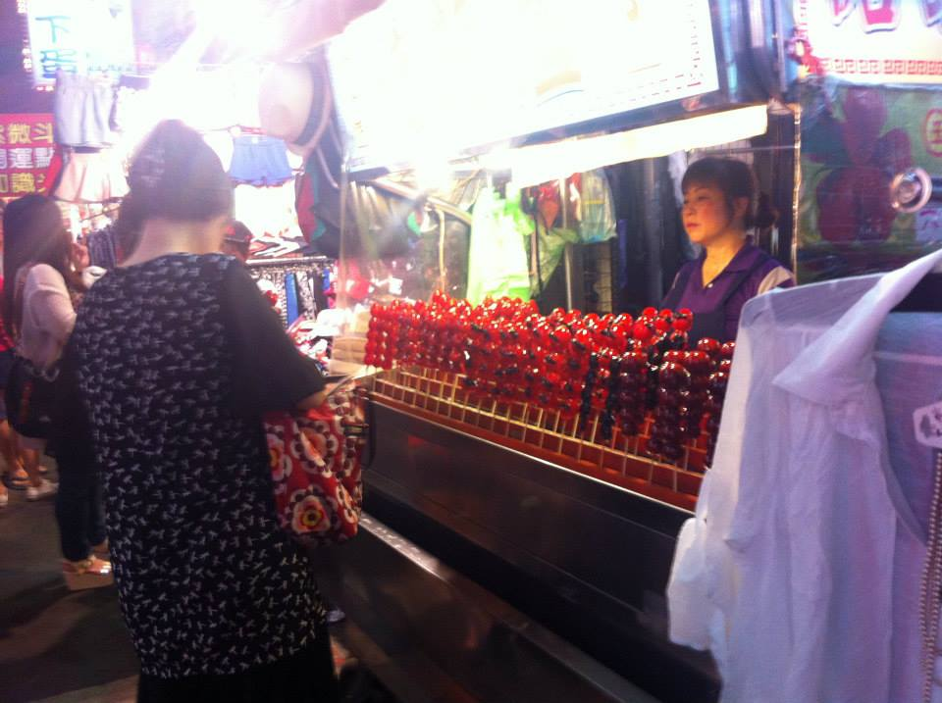
Culture
Shilin night market

Slide 6
Acknowledgments
UCSD (University of California San Diego)
Dr. Gabriele Wienhausen
Dr. Peter Arzberger
Dr. Rommie Amaro
Teri Simas
NTU (National Taiwan University)
Dr. Jung-Hsin Lin
Julia Brown Research Scholarship

